Slide 1

Project Title - Healthcare Analytics for Doctor Visits DIY Project
Student Name - Gangode Prathmesh Raghunath
AICTE ID – STU68f9f4033b6691761211395

Slide 2

PROBLEM STATEMENT
To analyze healthcare and doctor-visit data and identify patterns related to illness, income, gender, doctor visits, reduced activity, and health insurance coverage.

Slide 3
Project Description
A Python-based exploratory data analysis project that uses healthcare data to study patient characteristics and healthcare utilization through statistical analysis and visualizations.
Python libraries are used for data cleaning, statistical analysis, visualization, and correlation analysis to generate meaningful healthcare insights.

Slide 4

WHO ARE THE END USERS?
Healthcare data analysts
Healthcare researchers
Hospitals and healthcare organizations
Healthcare management teams
Students and researchers working in healthcare analytics
Data science and machine learning learners

Slide 5

Technology Used
Python
Jupyter Notebook
Pandas – Data processing
NumPy – Numerical analysis
Matplotlib – Data visualization
Seaborn – Statistical visualization
Anaconda – Development environment
GitHub – Project hosting

Slide 6
RESULTS
The project provides visual insights into illness distribution, income, doctor visits, gender-based reduced activity, insurance coverage, correlations, and missing values.
Demo Link

Slide 7
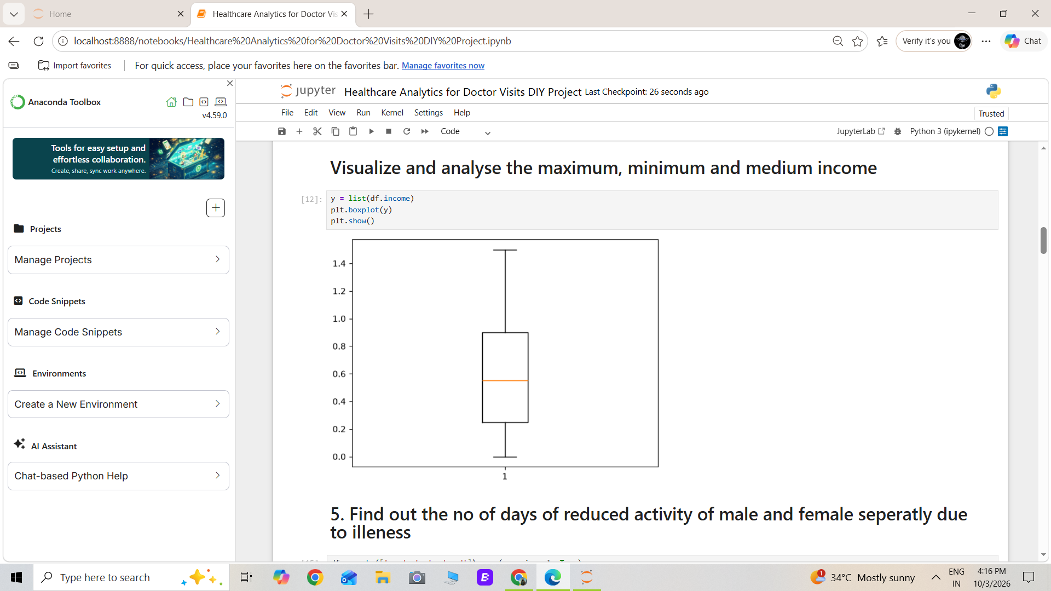
RESULTS

Slide 8
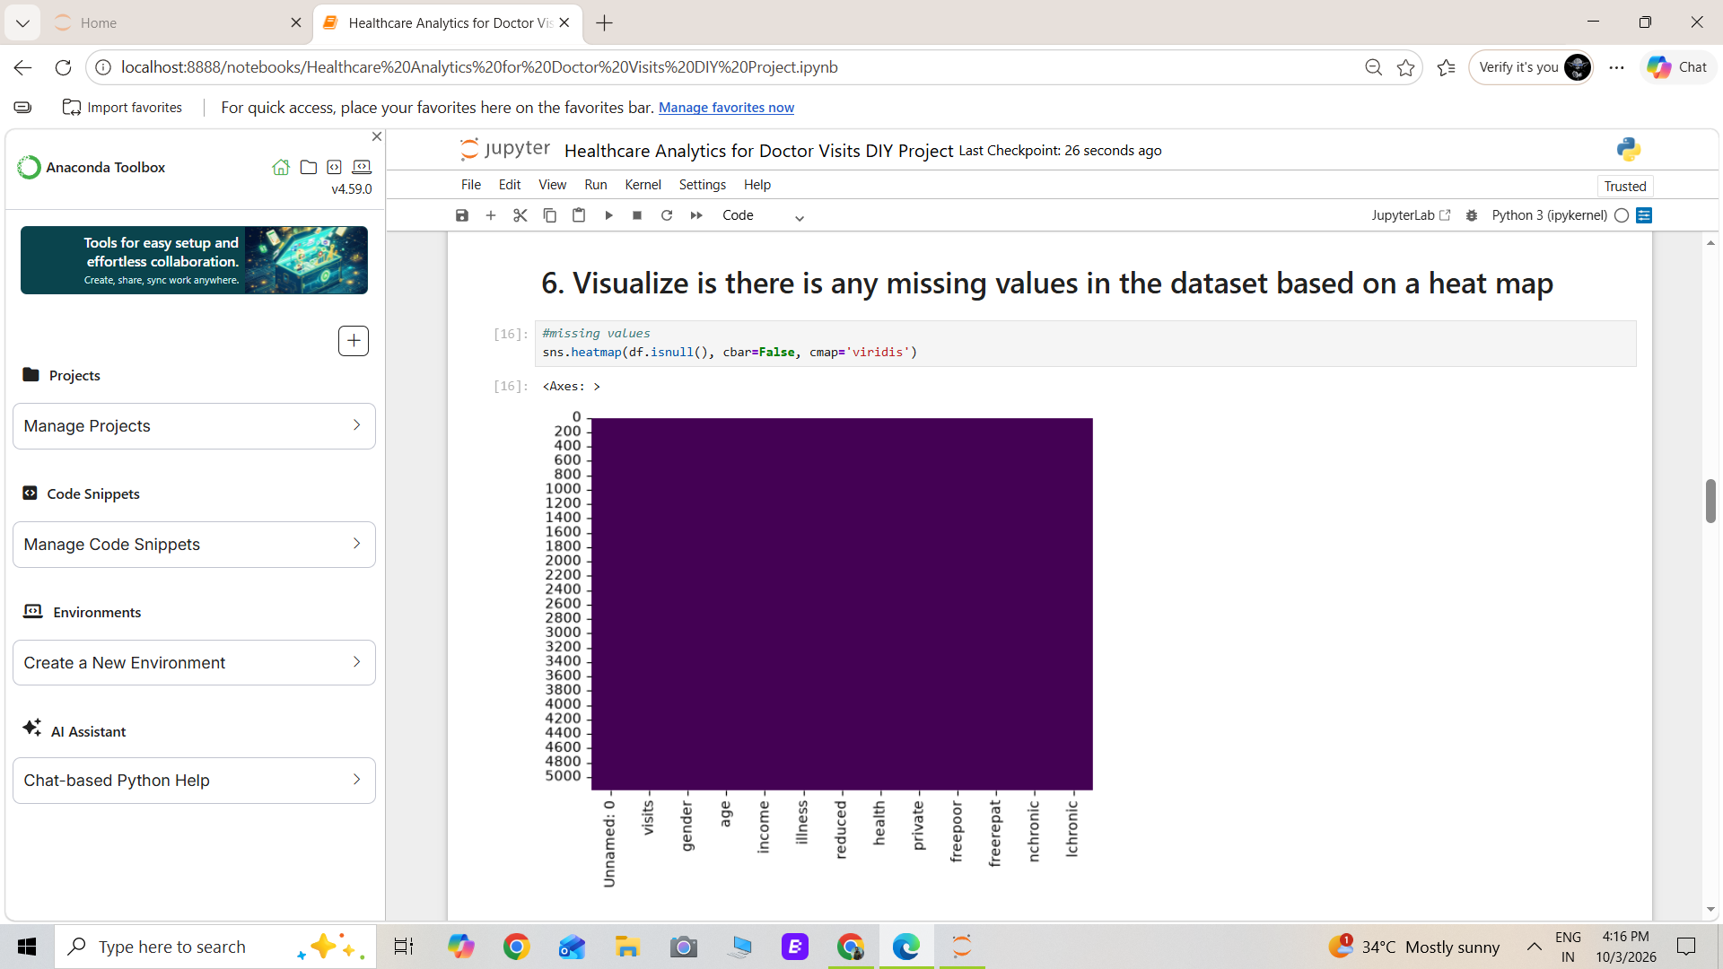
RESULTS

Slide 9
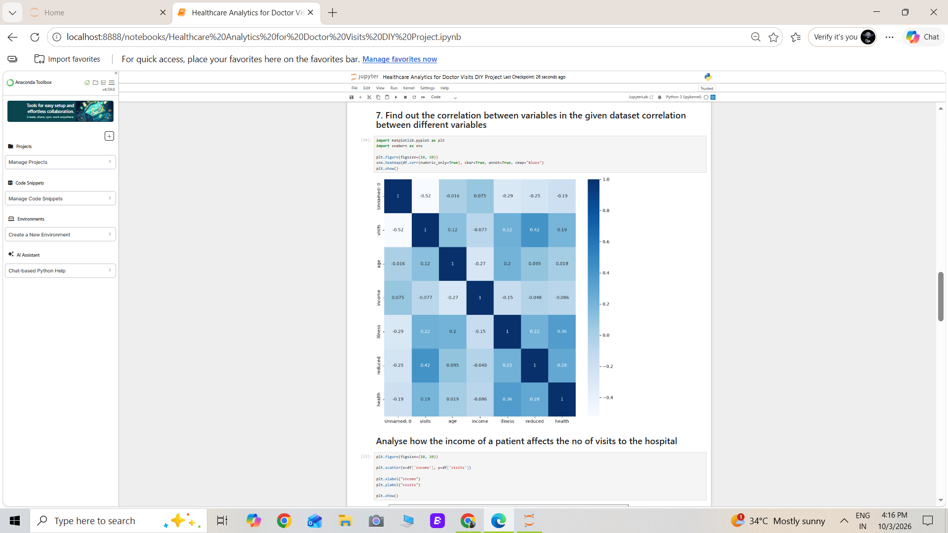
RESULTS

Slide 10
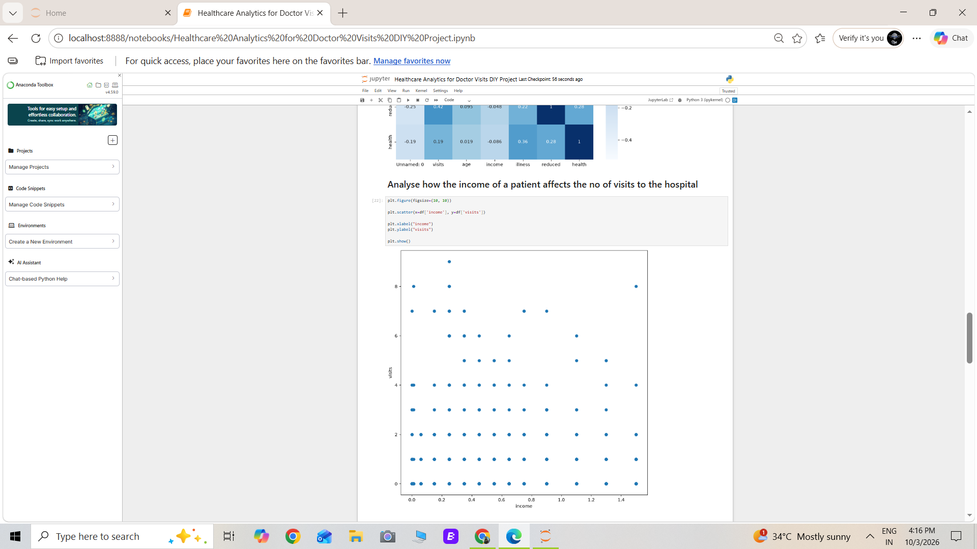
RESULTS

Slide 11
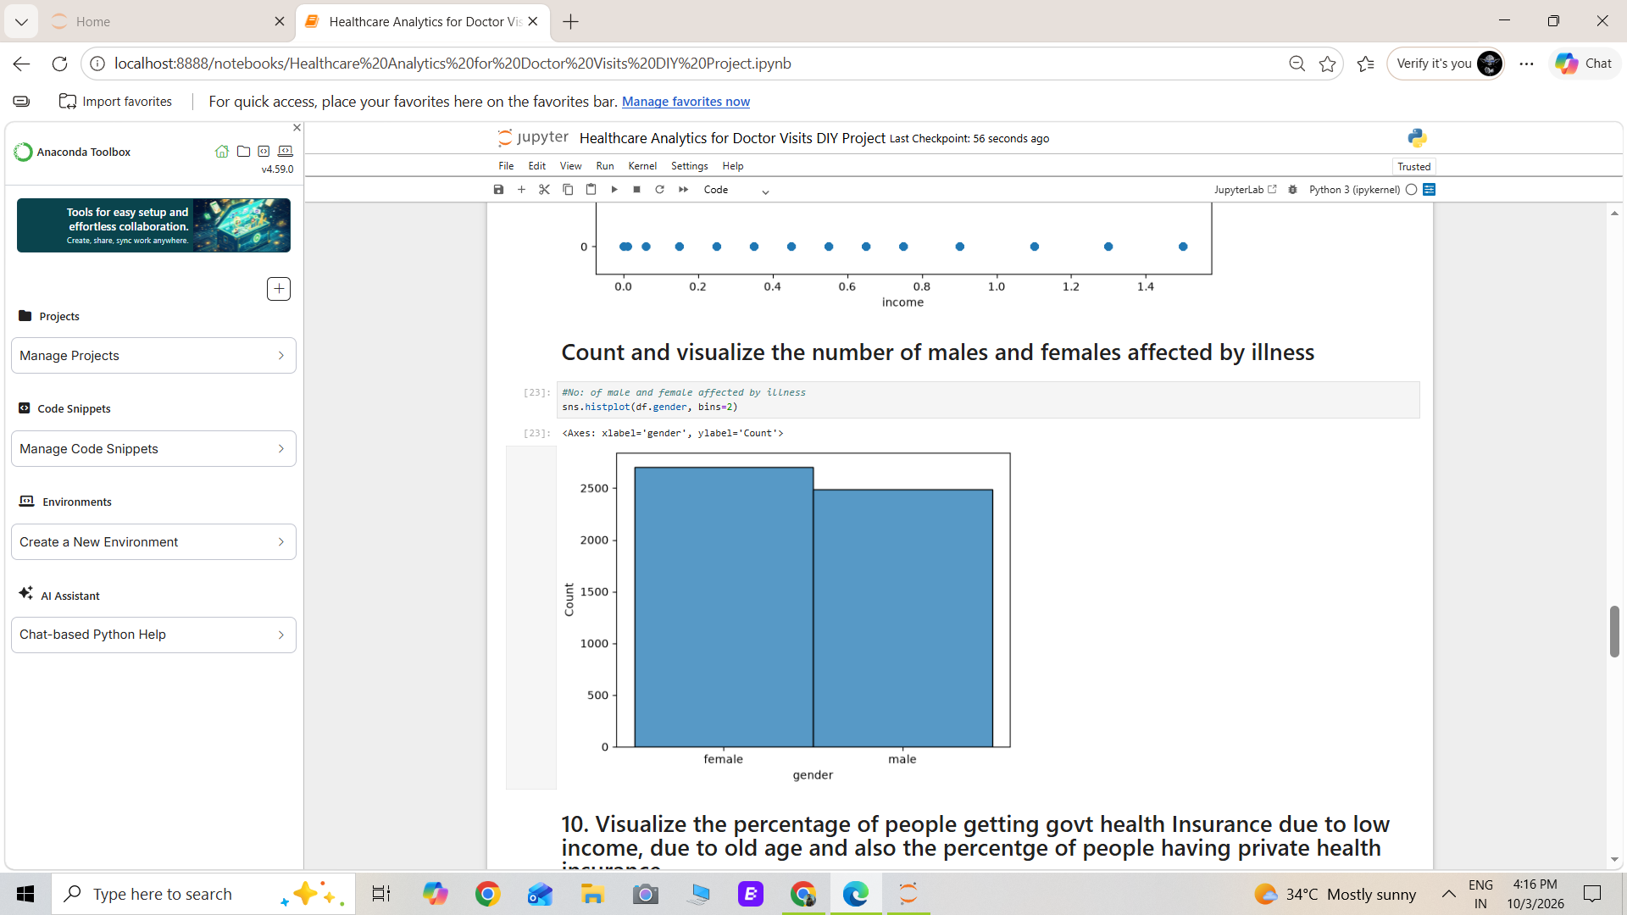
RESULTS

Slide 12
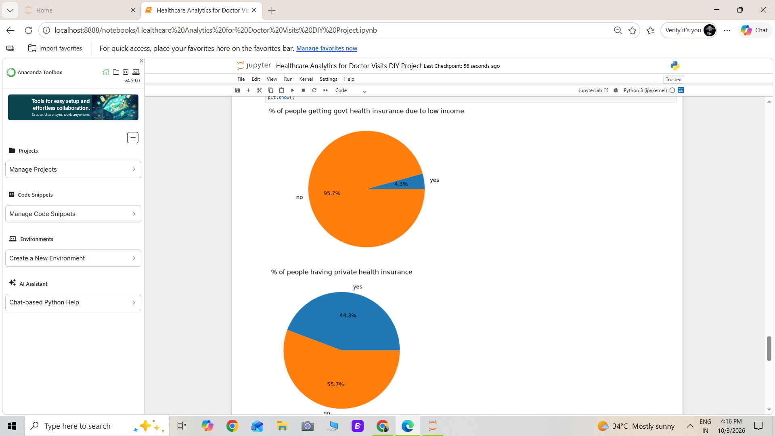
RESULTS

Slide 13
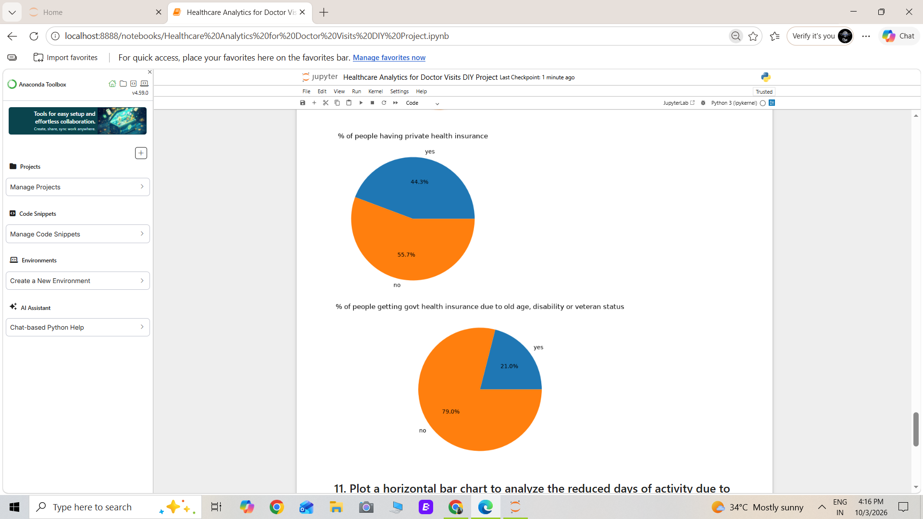
RESULTS

Slide 14
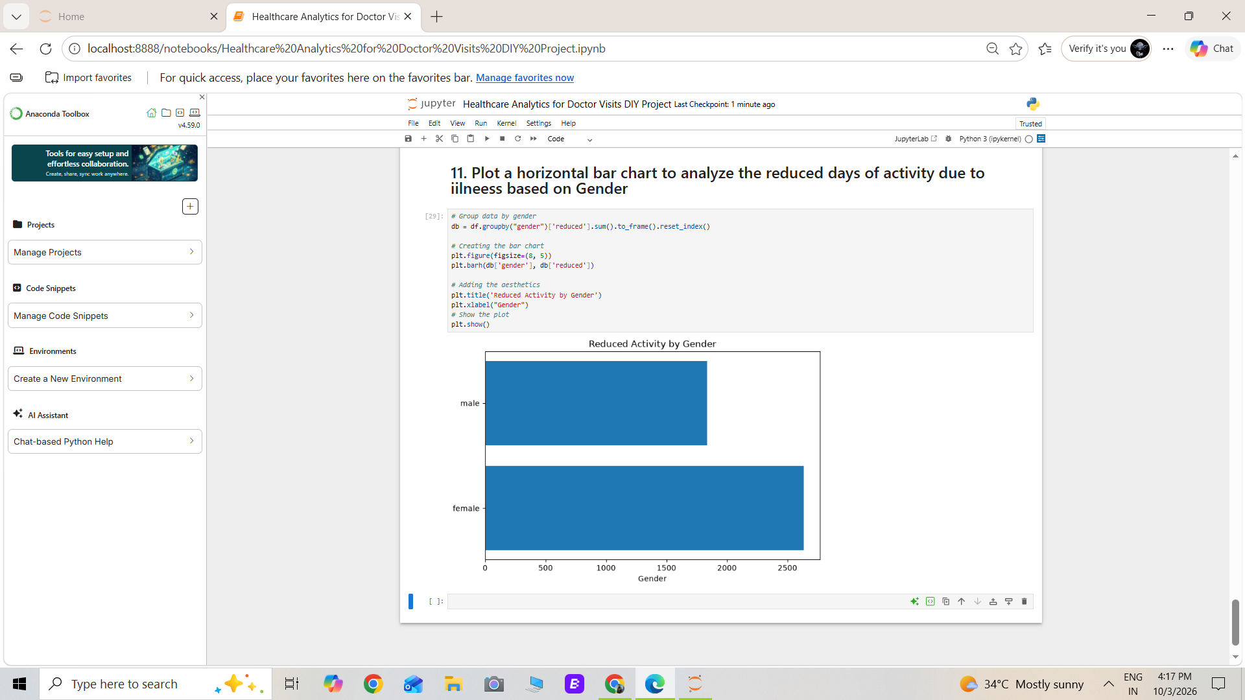
RESULTS

Slide 15
GitHub Link - https://github.com/Prathmg/Healthcare-Analytics-for-Doctor-Visits-DIY-Project
Student Name – Gangode Prathmesh Raghunath
AICTE ID – STU68f9f4033b6691761211395

Slide 16
Thank you
.
.

